Slide 1
Gestational Diabetes Mellitus
Cristian Ordoñez
DSMES Case Study Presentation
Preceptors: Mary Julius, RDN, LDN, CDE
Neal Kurmas, MS, RD, LD, CDE

Slide 2
Nutrition Assessment
Anthropometrics:
Age/Ethnicity: 38 yo AAF
Height: 5’5
Weight: 270 lb
BMI: 43.7
Target BW adj for Obesity: 161 lb
Gestational Diabetes Hx:
Pregnancy #1 2005 miscarriage at 9 weeks
Pregnancy #2 2016 GDM with return to normal following delivery
Pregnancy #3 2017 GDM, dx with T2DM after delivery
Pregnancy #4 2020 currently 7 weeks gestation
Notes:
The patient in question is a 38 year old AAF, she is 5’5, 270 lbs, has a BMI of 43.7 therefore classified as morbidly obese, and has a target BW adj for obesity of 161 lbs.
Veteran has a history of gestational diabetes in prior pregnancies. Her first pregnancy was in 2005 in which she suffered a miscarriage at 9 weeks gestation. Her second pregnancy was in 2016, where her glycemic control was able to return to normal after delivery. In 2017 she had her third pregnancy, where was again diagnosed with GDM. During this pregnancy Veteran became insulin dependent but following the delivery she was taken off of insulin. However her glycemic control did not return completely back to normal, and she was diagnosed with type 2 diabetes. And now she is currently at pregnancy #4 where she is at 7 weeks gestation, and she has now been provided with NPH insulin as of a few days ago.

Slide 3
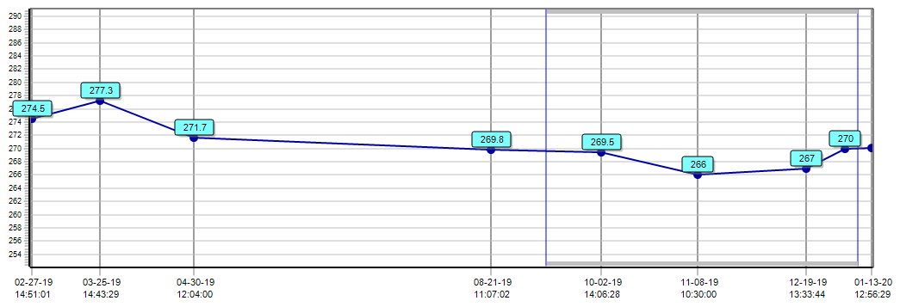
Nutrition Assessment (cont.)
Weight history:
Consistent 270-275 lbs past ~1 year
Labs:
HA1C
7.6 (2/27/19) → 6.5 (10/2/19) → 6.2 (1/3/20)
Low Vit D
Notes:
Her weight has been relatively stable in the past 1 year or so with no significant fluctuations, staying between 270 and 275#.
Her labs showed her HA1C to have been in a downward trend in the past 1 year, with her most recent reading showing a 6.2, so indiciating adequate glycemic control.
Her vitamin D levels were also low and therefore supplementation would be warranted.

Slide 4
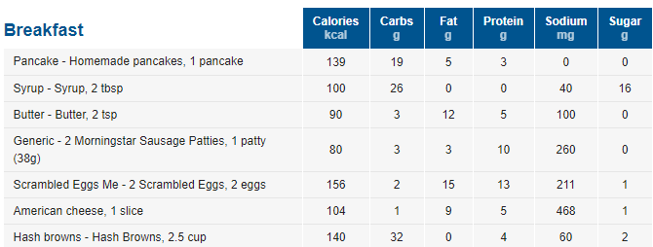

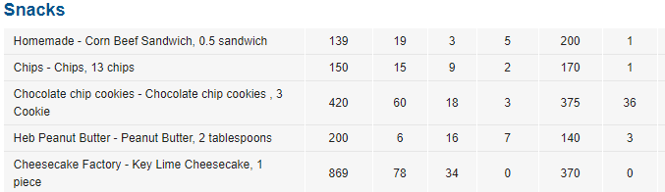
Nutrition Assessment (cont.)- Diet Recall
Diet Recall:

Slide 5
Distinction between GDM & T2DM Dx
GDM was previously defined as “any degree of glucose intolerance with onset of or first recognition during pregnancy ” - ADA 1997
Currently defined as GDM as “diabetes diagnosed in the second or third trimester of pregnancy that was not clearly overt diabetes prior to gestation” – ADA 2019
Recommendations:
Test for pre-existing diabetes in those with risk factors at first prenatal visit
Test for GDM 24-48 weeks gestation in women with no prior hx of DM
Test women with GDM for persistent DM at 4-12 weeks post-partum
Notes:
Unlike women with Type 1 diabetes, women with GDM have a lot of insulin, sometimes more than the average person. But insulin resistance increases due to a blocking effect of certain hormones produced by the placenta.
Some hormones that have this blocking effect are estrogen, cortisol, and human placental lactogen (HPL). As the size of the placenta grows, the number of these hormones produced increases along with the insulin resistance, therefore GDM is usually diagnosed about halfway through the pregnancy.
In most women the pancreas is able to produce more insulin to make up for the increased insulin resistance, but when the pancreas produces as much insulin as it can but it is still not enough to keep up with the insulin resistance of the placental hormones, then GDM occurs.
Risk factors are the same risk factors as those for type 2 diabetes
Diabetes that exists before this gestational period of 24-48 weeks (which is when amount of hormones released by pancreas that cause insulin resistance is high enough to lead to insulin resistance) is known as preexisting diabetes.

Slide 6
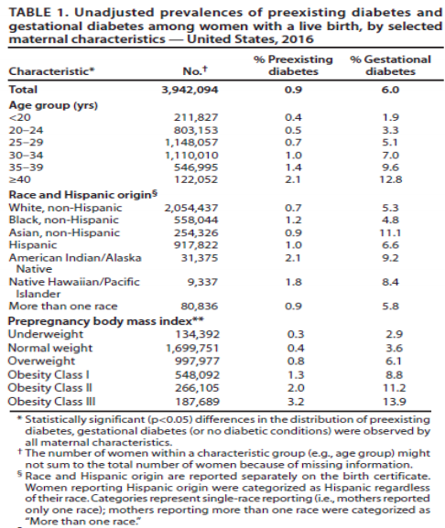
6% prevalence of GDM
GDM rates by race
Notes:
Prevalence of diabetes in the US is increasing along with the increase in obesity rates.

Slide 7
ADA Target Goals for Blood Glucose
Non-pregnant
Pregnant
Before Meals – 70-130 mg/dL
Two hours after meals < 180 mg/dL
Bedtime 110-150 mg/dL
Fasting ≤ 95 mg/dL and either
One hour after meal ≤140 mg/dL or
Two hours after meal ≤120 mg/dL
Why do pregnant women require lower BG target goals?
Uptake of glucose by the fetus and placenta
Increase in diabetogenic placental hormones
Postprandial hyperglycemia
CHO intolerance

Slide 8
Fetal/Neonatal Risks due to GDM
LGA or macrosomia (birth weight > 90th %tile)
Preeclampsia
Neonatal hypoglycemia
Birth Trauma – shoulder dystocia, brachial plexus injury

Slide 9
Evidence-Based Nutrition Practice Guidelines for GDM
ADA MNT goals
Achieve normoglycemia
Prevent ketosis
Provide adequate gestational weight gain based on maternal BMI
Contribute to well-being of fetus
Self management is essential aspect of MNT
Blood glucose monitoring
Diet (DRI for pregnant women)
PA
Notes:
file:///Users/cristianordonez/Downloads/GDM_AND_Gestational%20Diabetes%20Evidence-based%20Nutrition%20Practice%20Guideline%202018%20(1).pdf

Slide 10
Nutrition Diagnosis
Excessive energy intake
Related to: dietary indiscretions, increased appetite 2/2 pregnancy
As evidenced by: diet recall, BMI of 45

Slide 11
Nutrition Intervention
Educated on carbohydrate counting and important of SMBG
Offered alternative cooking methods & snack dietary options
Coordinate with endocrine to provide CGM
Vit D supplementation

Slide 12
Monitoring & Evaluation
1. Weight
Goal: Wt gain 11-20# throughout course of pregnancy.
2. Labs
Goal: before meal glucose double digit, post prandial less than 140.
Follow-up
NPH insulin provided
CGM pain
7x/day SMG
Notes:
Was not previously on insulin, but prior history with GDM shows she will most likely need to be provided with insulin as pregnancy progresses and insulin resistance increases.

Slide 13
References
Duarte-Gardea MO et al. J Acad Nutr Diet 2018;118:1719-1742.
Management of diabetes in pregnancy: Standards of medical care in diabetes--2019. Diabetes Care 2019;42(suppl 1):S165–S172; CDC. National Diabetes Statistics Report, 2017. https://www.cdc.gov/diabetes/data/statistics-report/index.html
Maria O. Duarte-Gardea, Diana M. Gonzales-Pacheco. Academy of Nutrition and Dietetics Gestational Diabetes Evidence-Based Nutrition Pratice Guideline. Journal of The Academy of Nutrition and Dietetics.
Nielsen GL, Møller M, Sørensen HT. HbA1c in early diabetic pregnancy and pregnancy outcomes: a Danish population-based cohort study of 573 pregnancies in women with type 1 diabetes. Diabetes Care 2006;29:2612–2616
Maria O. Duarte-Gardea, Diana M. Gonzales-Pacheco. Academy of Nutrition and Dietetics Gestational Diabetes Evidence-Based Nutrition Pratice Guideline. Journal of The Academy of Nutrition and Dietetics.
Notes:
American Cancer Society (ACS), US Multi-Society Task Force on Colorectal Cancer, and American College of Radiology

